Slide 1
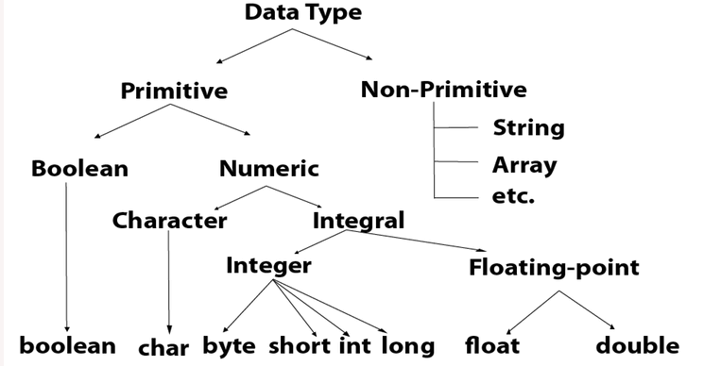
Data Types

Slide 2
Question1
Write a java program to count occurrences of each character in String in java. If the String is "Java Hungry" then the answer should be { v=1, a=2, r=1, u=1, v=1, g=1, H=1, y=1, J=1, n=1}

Slide 3
Question2(Array)
Write a java program to find common elements between the two given arrays. Suppose given two arrays array1= {1,4,7, 9, 2} arrray2 = {1,7,3,4,5} the answer should be {1,4,7}

Slide 4
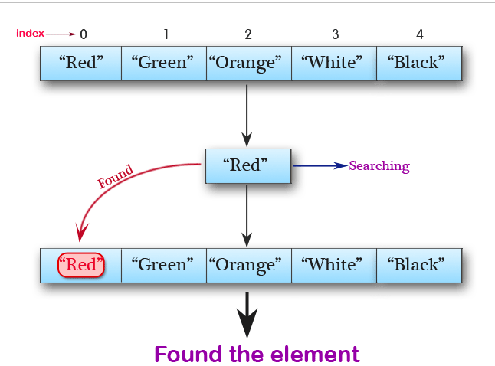
Question3(Array List)
Write a Java program to search an element in a array list

Slide 5
Object-Oriented Programming.
Class:- blue-print of the object that is called class
Ex:- Fruits
Object:- Define the state or behavior of the class that is called object
Apple,Orange,Mango

Slide 6
Modifiers
Access Modifiers - controls the access level
Public :-The class is accessible by any other class
Private:-The code is only accessible within the declared class
default:-The code is only accessible in the same package
Protected:-The code is accessible in the same package and subclasses.

Slide 7
Modifiers
Non-Access Modifiers - do not control access level, but provides other functionality
Final:- Attributes and methods cannot be overridden/modified.
Static:- Attributes and methods belongs to the class, rather than an object.

Slide 8
Oop Concepts
Encapsulation:- object-oriented procedure of combining the data members and data methods of the class inside the user-defined class. It is important to declare this class as private.(Hidden the data from the users )
Ex:capsules

Slide 9
Inheritance
Inheritance (Subclass and Superclass)
subclass (child) - the class that inherits from another class
superclass (parent) - the class being inherited from
To inherit from a class, use the extends keyword

Slide 10
Polymorphism
Implementing the Same thing in different way
Method Overloading(Run-time Polymorphism )
If a class has multiple methods having same name but different in parameters.
Method Overriding(Compile-timePolymorphism)
If subclass (child class) has the same method as declared in the parent class

Slide 11
Abstraction
Abstraction is a process of hiding the implementation details and showing only functionality to the user.

Slide 12
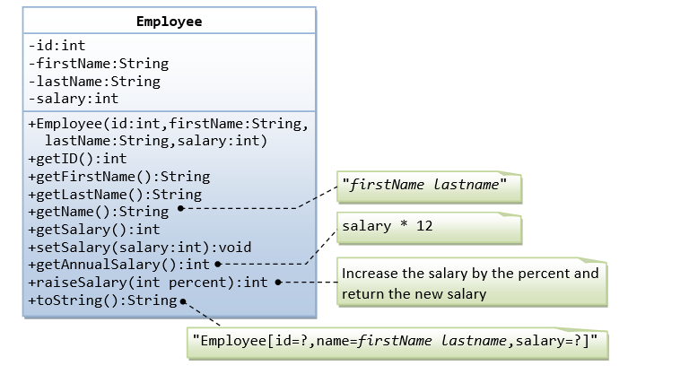
Question
A class called employee, Which models an employee with the id, name ,salary, is designed as shown in the following class diagram

